Slide 1



Developing a Machine Learning Based Classifier for Identifying Exceptional Facts in Text
Alishbah Fahad

Slide 2
Project Significance & Objective
Significance:
Objective:
The goal is to develop a machine learning classifier that can precisely identify exceptional facts within text.
This classifier will help users efficiently extract valuable information from large volumes of text data.
In an age where data is abundant, the real challenge lies not in its accumulation, but in the extraction of meaningful insights.
The ability to pinpoint essential facts within extensive datasets is invaluable for:
Assisting decision-makers across fields in navigating information-rich environments.
Enabling journalists to weave factual, engaging stories.
Facilitating breakthroughs in research.
Notes:
When we find these exceptional facts, they can help people in many ways. They can make news stories more powerful, help students and teachers learn new things, and help businesses make better decisions.

Slide 3
DEFINING Exceptional Fact
An exceptional fact is a way of highlighting the rare characteristics of a particular entity within a larger group.
Entity of Interest: The specific subject which the fact is about.
Context: The group within which the entity is being compared.
Qualifying Attributes: The distinct traits that make the fact noteworthy.
Notes:
It's like finding the one red apple in a basket full of green ones.
For every exceptional fact, the entity of interest stands out as one of the few, or the only entity within the context that exhibits a particular combination of the qualifying attributes.

Slide 4

Understanding Exceptional Fact Through Example
Statement: “Denzel Washington followed Sidney Poitier as only the second black to win the Best Actor award.” (Source: abcnews.go.com)
Entity of Interest: Denzel Washington
This is the person we are interested in, the central subject of our exceptional fact.
Context: Best Actor award winners
This group comprises individuals who have won the Best Actor award, providing a basis for comparison.
Qualifying Attributes: Ethnicity
Focusing on the attribute of ethnicity among Best Actor recipients.
Peculiar Value: African American
Denzel Washington's exceptional quality within this context is his status as only the second African American winner.
Notes:
Thus, Denzel Washington stands out among Best Actor award winners because he is one of the very few who are African American, making this an exceptional fact.

Slide 5
Methodology
Sentence Collection
Human Annotation
Classifier Development and Sentence Classification

Slide 6
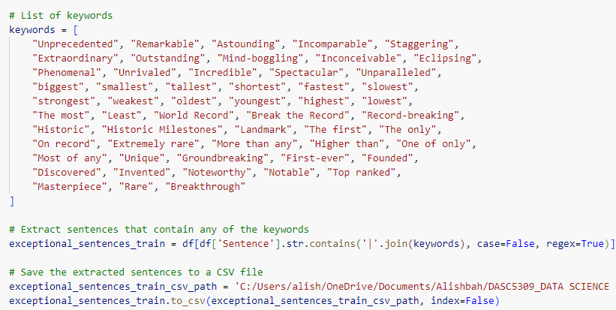
Phase 1: Sentence Collection
Identified 55 keywords through analysis of existing exceptional facts.
Applied keyword-based search to extract sentences from Wikipedia.
Selected the film industry domain to narrow down the data collection, providing a rich and diverse source of exceptional facts related to cinematic achievements and milestones.

Slide 7
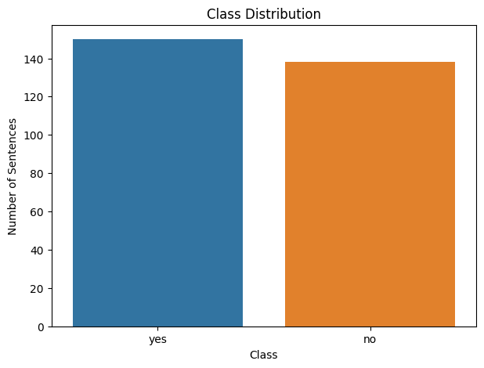
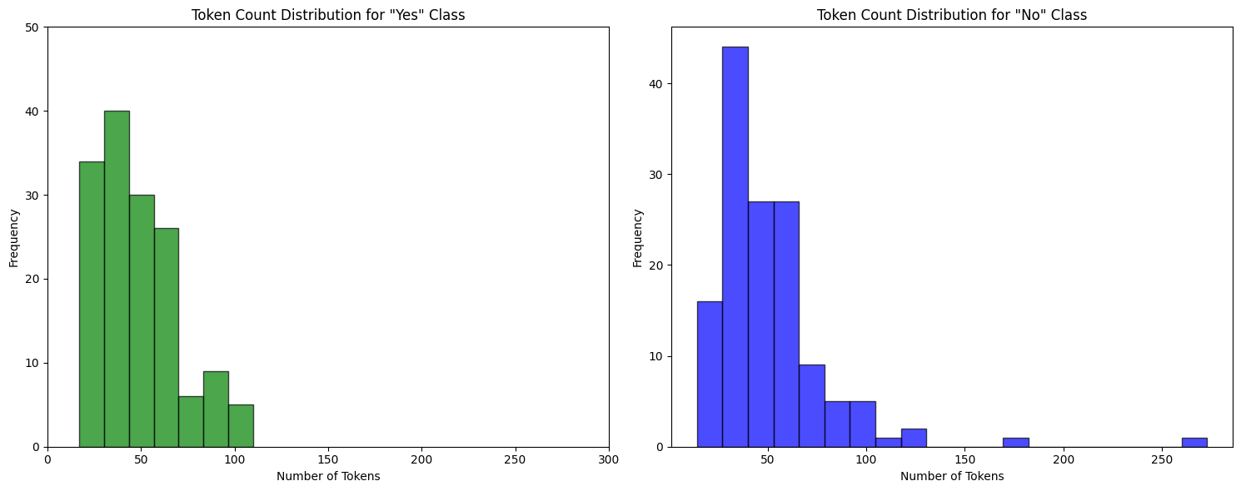
Phase 2: Human Annotation
Annotated 288 sentences, labeling 150 as "Yes" and 138 as "No" for exceptional facts.
Annotated sentences based on the predefined criteria of 'exceptional facts'; sentences meeting the criteria as defined were labeled "Yes", while those not aligning with the definition were labeled "No".

Slide 8
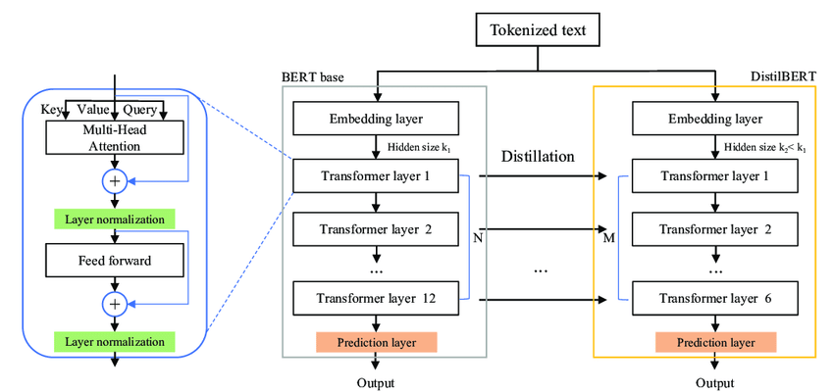
Phase 3: Classifier Development and Sentence Classification
Choose a suitable machine learning algorithm DistilBERT, for text classification.
Selected DistilBERT for its ability to deliver comparable performance to larger models while being more practical for smaller datasets. Given the limited dataset of 288 sentences annotated single-handedly due to time constraints, DistilBERT's streamlined architecture allowed for efficient training without compromising the quality of the machine learning model.
Train the model on the annotated dataset, allowing it to learn the features of exceptional facts.
The trained classifier can then predict whether new sentences contain exceptional facts.
Due to limited computational resources, focused on finding the best train-test split (85-15) for performance evaluation.
Further hyperparameter tuning and fine-tuning were not possible within the allotted timeframe.

Slide 9
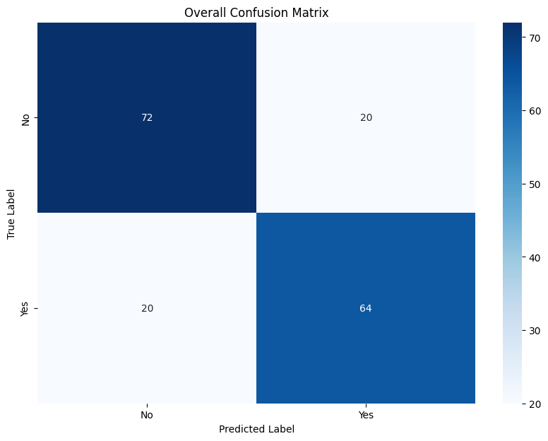
Evaluation and Fine-tuning
Evaluation:
Conducted a stratified K-fold for cross-validation analysis with the following average metrics across 5 folds:
Accuracy: 77.26% (± 1.82 %)
Precision: 76.47 % (± 2.91 %)
Recall: 76.32 % (± 7.21 %)
F1 Score: 76.10 % (± 2.52 %)
These metrics suggest the classifier has a robust performance with a balance between precision and recall.
Each fold represents a subset of the dataset, ensuring that the evaluation is thorough and unbiased.
Fine-tuning Process:
Due to time constraints, further optimization based on these metrics was limited.
Future efforts will focus on enhancing precision and recall, potentially improving the F1 score.
The fine-tuning will aim to address specific misclassifications highlighted by the confusion matrix.

Slide 10
Project Insights: Strengths and Limitations
Strengths
Feasibility: Successfully demonstrated the effectiveness of using keyword-based searches to extract important information from extensive text collections.
Evaluation: Preliminary tests of the classifier show high accuracy in distinguishing exceptional facts, with metrics indicating a reliable performance.
Applications: Explored a range of potential applications, suggesting the classifier's versatility across various fields such as journalism, research, and information technology.
Limitations
Dataset Size: While the results are promising, the relatively small dataset may impact the classifier’s predictive robustness across broader applications.
Tuning: Constraints on time prevented extensive hyperparameter tuning and fine-tuning, which are typically necessary to optimize a model's performance.
Annotation Bias: As the sole annotator, there's a risk of introducing subjective bias, highlighting the need for a larger, diverse annotation team in future work.

Slide 11

Future Prospects
Foundation for Innovation: Our project leads the way in creating new tools that make it easier to find exceptional facts in large collections of text.
Transformative Applications: We expect big changes in:
Academic Research: Quickly find important new studies.
Journalism: Discover interesting stories from old data.
Healthcare: Get important information from patient records to make care better.
Towards Smarter Technologies: We could see:
Better search engines that find detailed information.
AI that chooses content just for you.
Advanced platforms for looking closely at data.
Continued Development: We're dedicated to:
Making our datasets bigger and more varied.
Improving our algorithms to be more accurate.
Working with different areas to use all our skills.

Slide 12
Acknowledgements
Expressing sincere gratitude to IDIR LAB for their invaluable support and resources throughout the project.
Special thanks to Dr. Li for providing expert guidance and continuous mentorship.
Appreciation for Nasim’s consistent help and contributions, playing a significant role in the project's success.

Slide 13



